Slide 1
TOOL WEAR PREDICTION
A layered methodology study on the PHM tool wear dataset
Dataset
Best model
10 experiments · 1 tool (T01) · Target: VB_µm
ElasticNet → MAE = 26.92 µm
Validation
Winning branch
LOEO-CV · 10 folds · honest
A_ST_feature_noise (no tuning, augmented data)

Slide 2
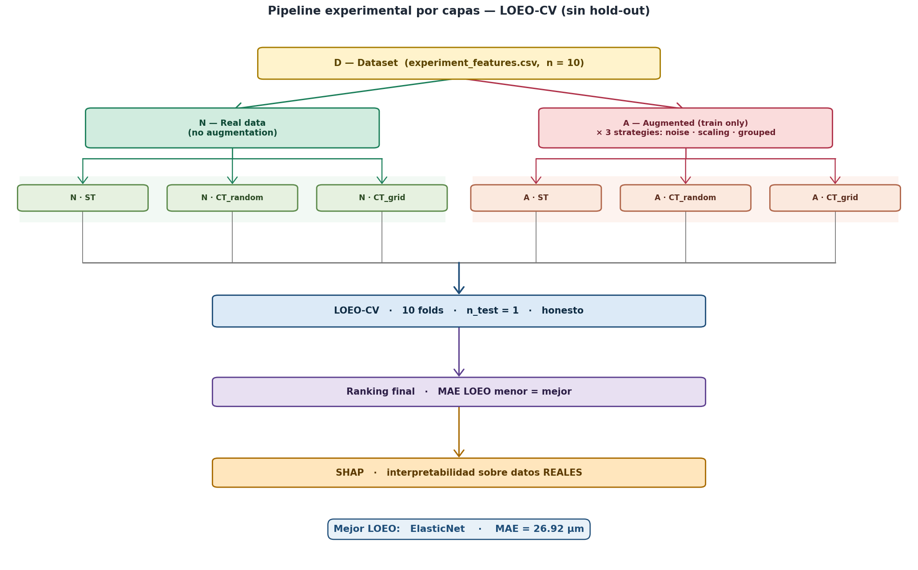
The pipeline at a glance
From raw data D, two parallel data branches (Normal / Augmented), three tuning options, single LOEO-CV evaluator, ranking, then SHAP.

Slide 3
STEP 1
Data Quality Audit
Before training any model: what do we actually have on disk, and is the target variable usable? Ten experiments, one tool life cycle, contact-mounted measurements.

Slide 4
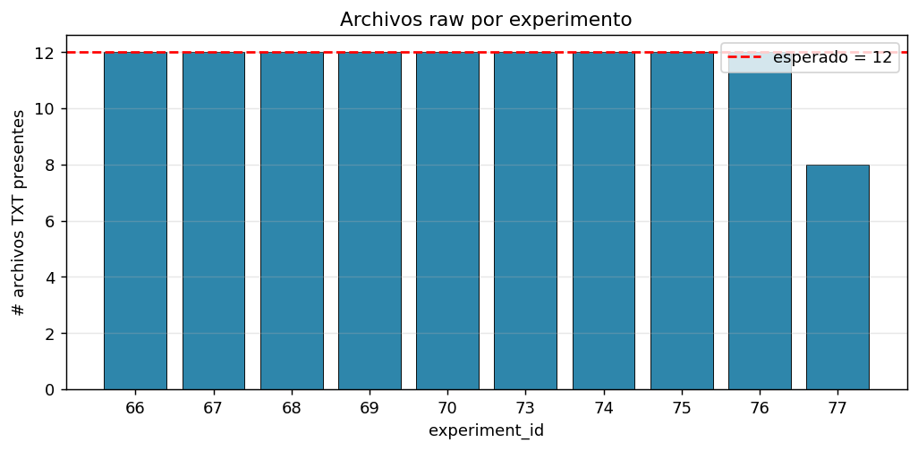
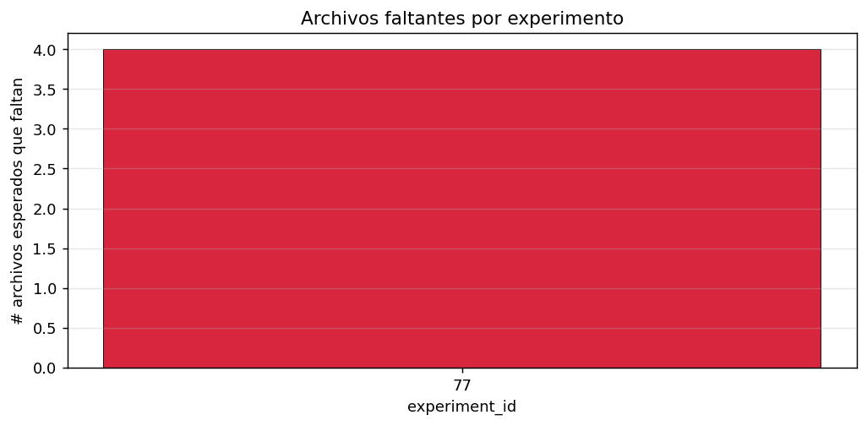
What is on disk
Per-experiment file inventory and missing-segment audit.
Files per experiment
Missing segments by experiment

Slide 5
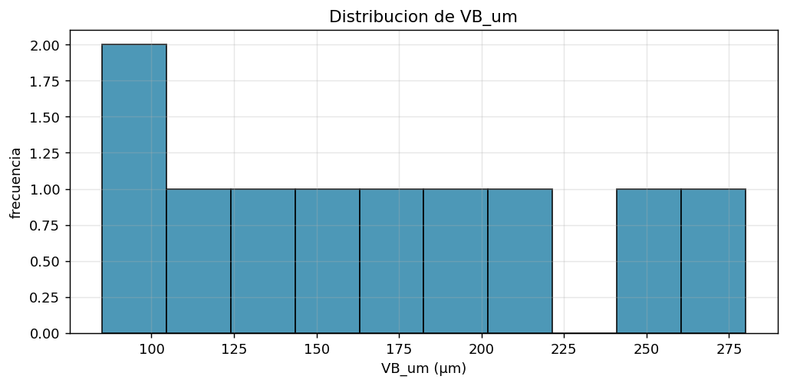
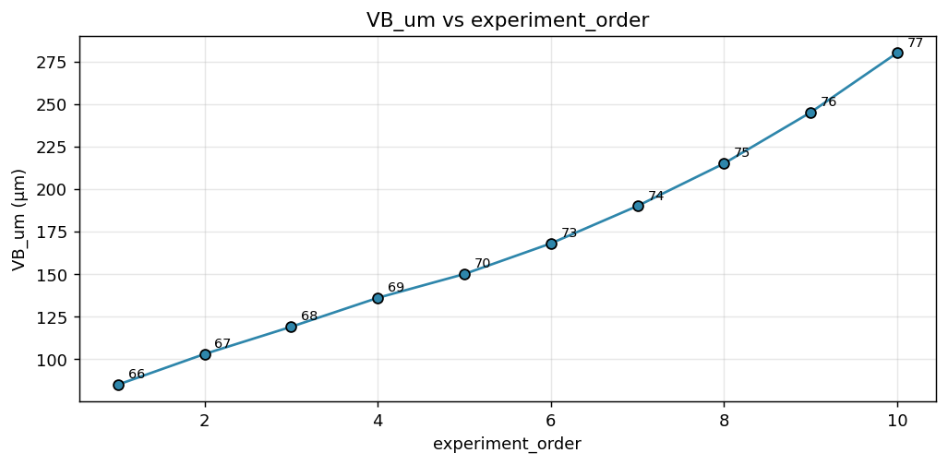
The target variable VB_µm
Range, distribution and trajectory across the 10 experiments. No replicates per experiment — each VB is a single measurement.
VB_µm distribution (n=10)
VB_µm versus experiment order

Slide 6
STEP 2
Baseline — N_ST
Normal data, no tuning, no augmentation. Eight regressors trained with default hyper-parameters. This is the bar everything else must beat.

Slide 7
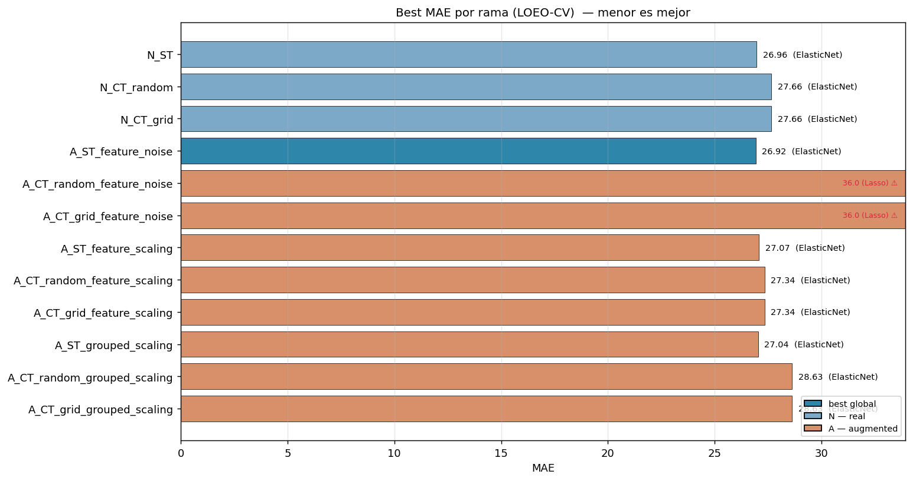
Baseline performance (N_ST)
ElasticNet emerges as the strongest baseline. Tree-based and kernel models underperform with only 8 training rows.
BASELINE (N_ST)
MAE 26.96 µm
RMSE 37.88 µm
R² 0.602
MAPE 17.0 %
winning model: ElasticNet
config: normal data, no tuning, no augmentation
training rows: 8 · test rows: 1 per fold · 10 folds
MAE by branch — N_ST highlighted in context

Slide 8
STEP 3
Tuning Effect — Does It Help?
RandomizedSearchCV vs GridSearchCV on top of normal data. Search is performed once over the train pool with internal GroupKFold; best params are then reused inside LOEO folds.

Slide 9
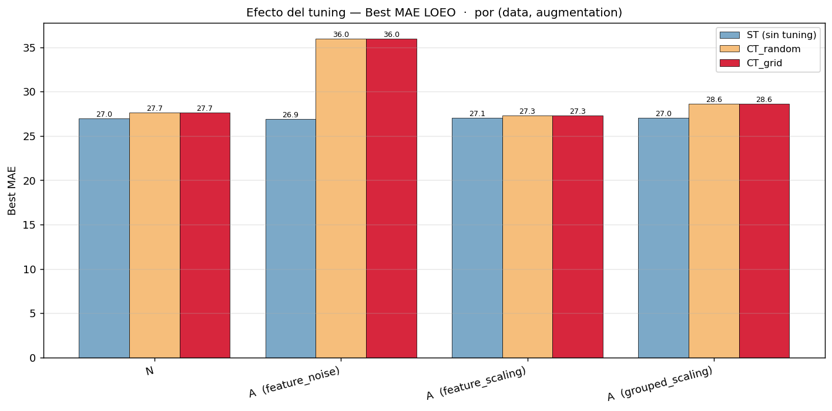

Tuning effect by data branch
Random vs Grid vs no-tuning. With n=8 train rows, search spaces are intentionally small — tuning can only do so much.
MAE
RMSE

Slide 10
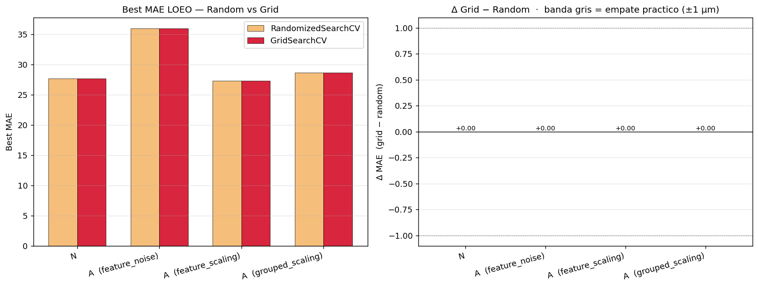
Random vs Grid search
With such small search spaces the two methods converge on the same hyper-parameters — Random and Grid produce identical metrics for most models. Grid did not find anything Random missed.
MAE — Random vs Grid across models

Slide 11
STEP 4
Data Augmentation
Three perturbation strategies applied to training rows only: feature_noise (Gaussian), feature_scaling (multiplicative), grouped_scaling (per feature-group). Real test rows are never touched.

Slide 12
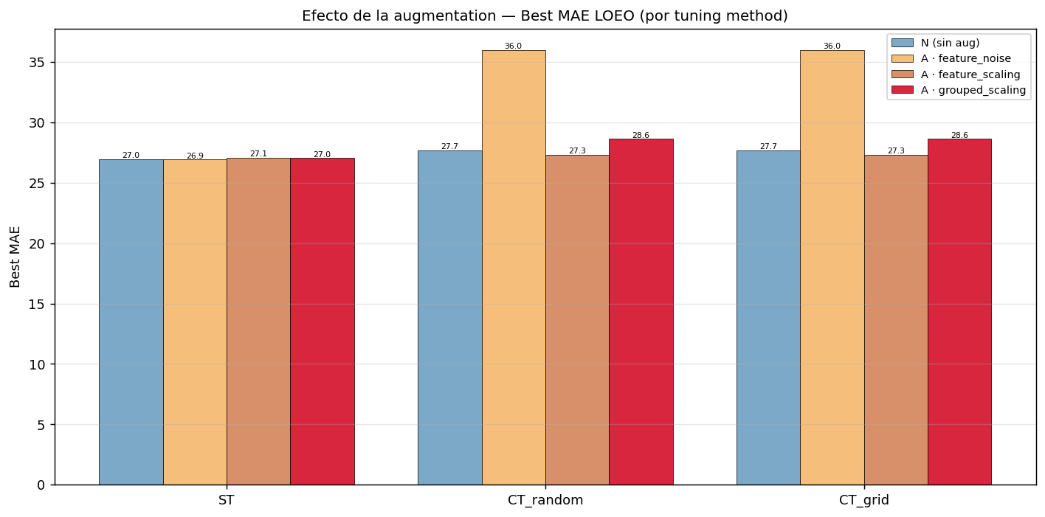

Augmentation effect by strategy
Augmentation alone (A_ST) is essentially neutral on MAE. feature_scaling visibly reduces RMSE — outliers shrink.
MAE
RMSE

Slide 13
STEP 5
Branch-Level Comparison
All twelve branches side by side: per-branch best, deltas against baseline, and full model × branch heatmaps.

Slide 14
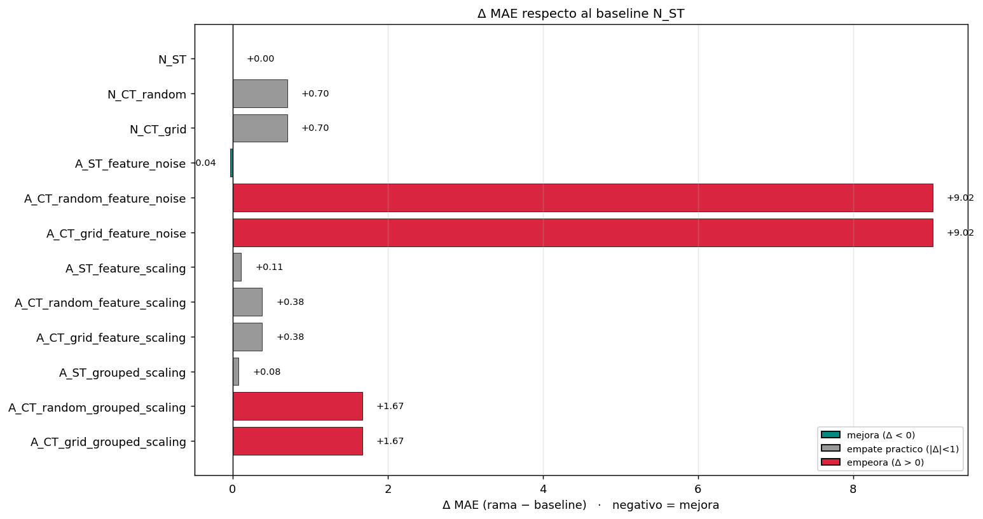
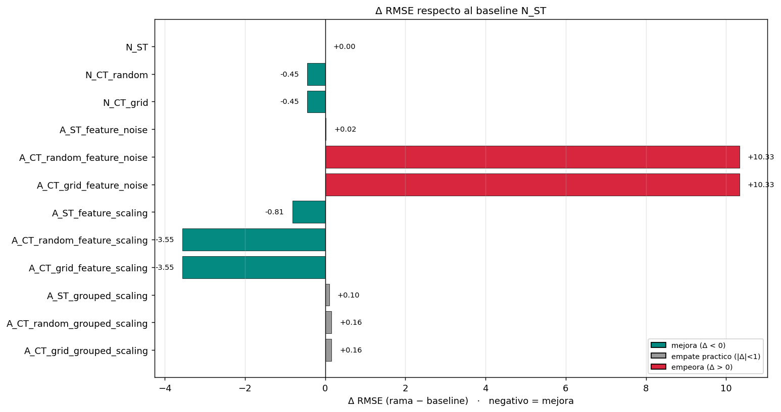
Δ versus baseline N_ST
Negative = improves. Most branches sit within a "practical tie" band (|Δ MAE| < 1 µm). The only branch with a clear MAE bump is A_CT_*_feature_noise (Lasso falls apart).
Δ MAE
Δ RMSE

Slide 15
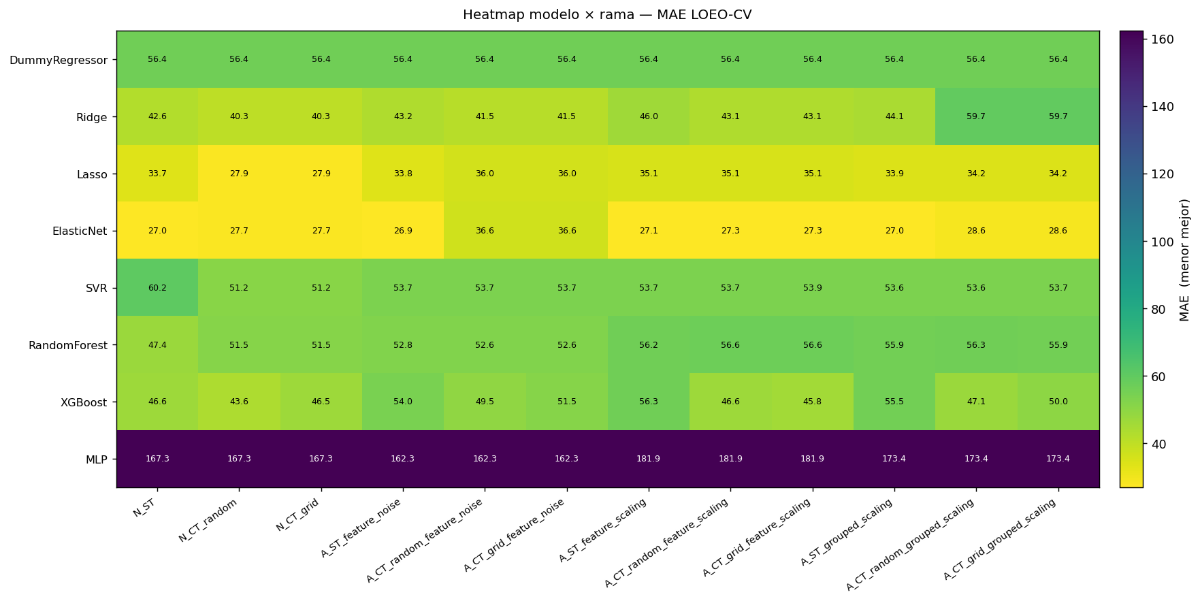
Model × branch heatmap — MAE
Linear models (Ridge, Lasso, ElasticNet) dominate. Nonlinear models suffer the small-sample curse.

Slide 16
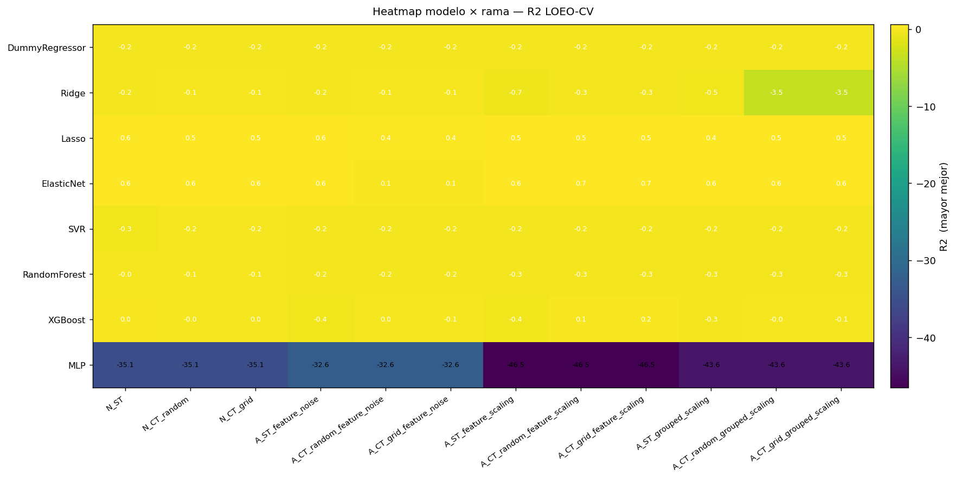
Model × branch heatmap — R²
Same shape: linear-regularized methods explain the most variance; tree ensembles often go negative.

Slide 17
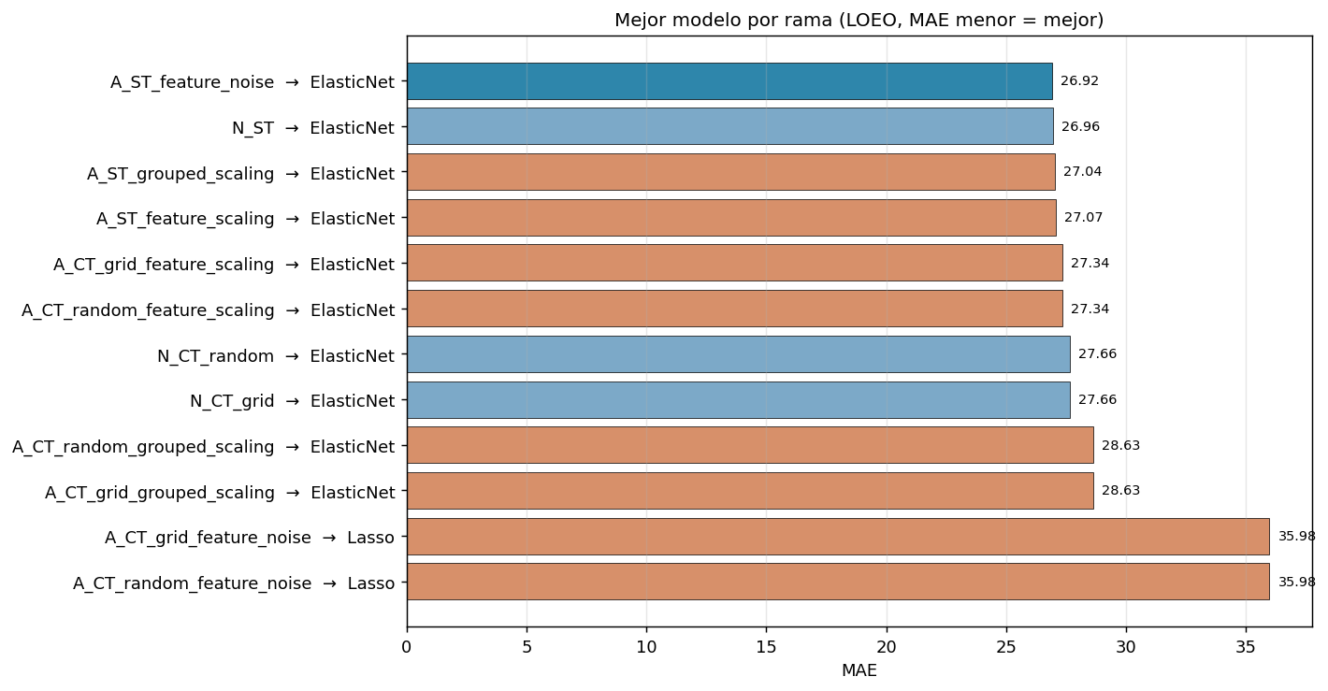
Best model per branch
ElasticNet wins ten out of twelve branches; the remaining two (A_CT_*_feature_noise) collapse onto Lasso.

Slide 18
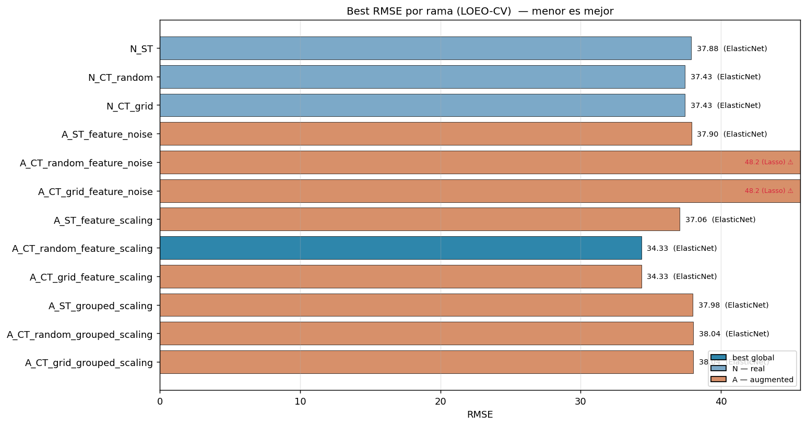
Branch performance — MAE & RMSE
Lower is better. The 12 branches cluster in a tight band, with A_ST_feature_noise marginally on top by MAE.
MAE
RMSE

Slide 19
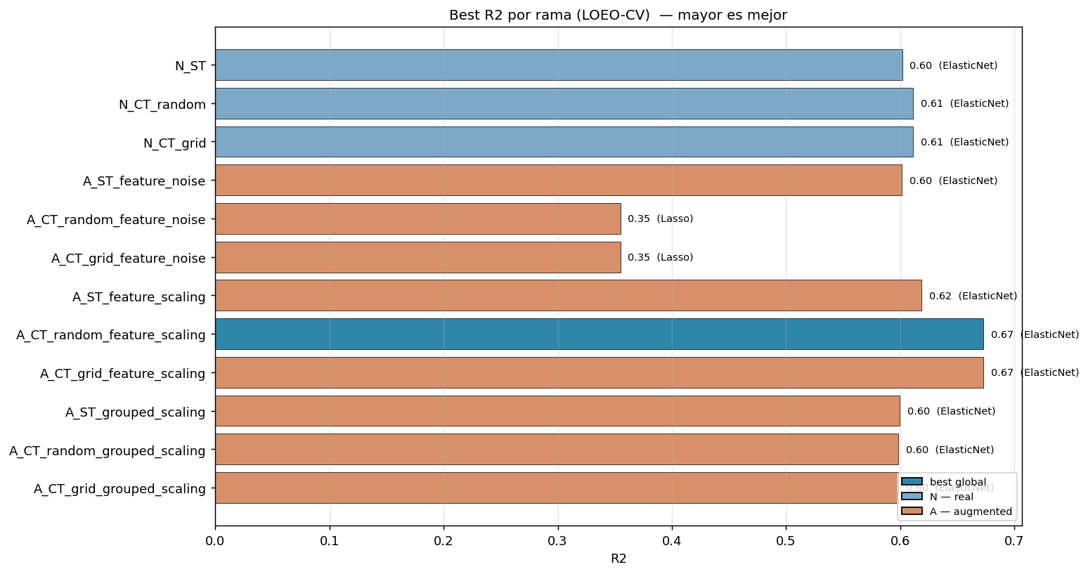
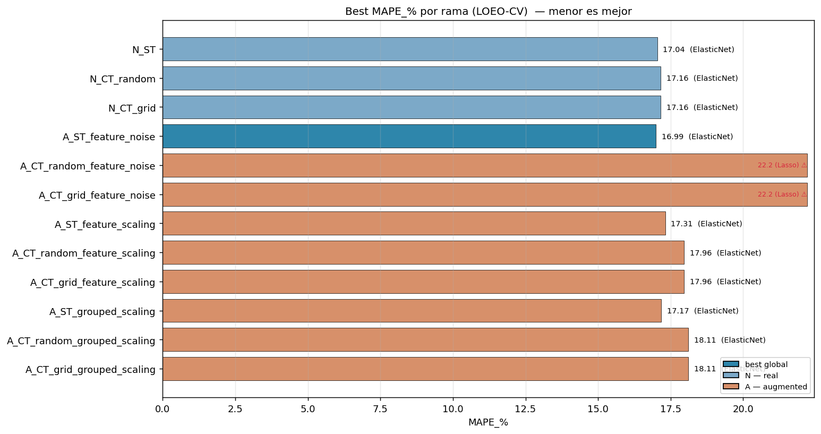
Branch performance — R² & MAPE
R² ranking partly disagrees with MAE: A_CT_feature_scaling branches score the highest R² (better calibrated residuals).
R² (higher is better)
MAPE (lower is better)

Slide 20
STEP 6
Sequential Story
Following a practitioner's mental walk: baseline → tuning → augmentation → both. Did each layer of complexity pay off?

Slide 21
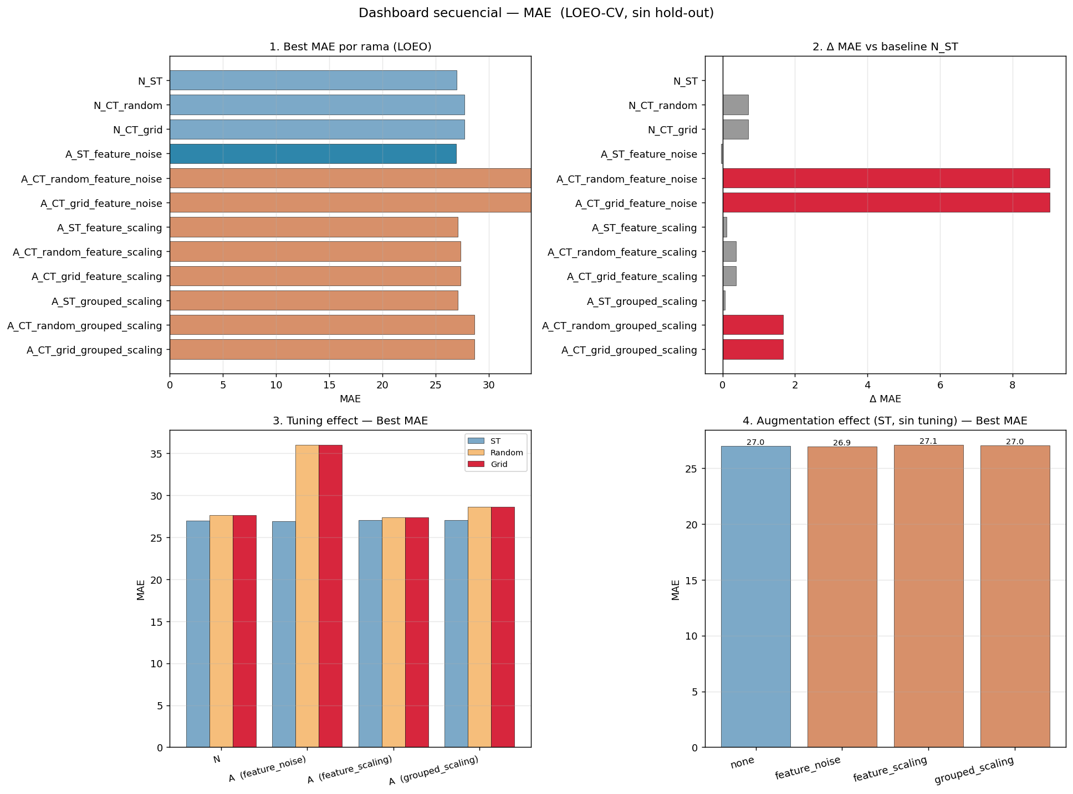
Sequential dashboard — MAE
Four panels showing the four moves a practitioner would try. On MAE, the gains across stages are within noise (n=10).

Slide 22
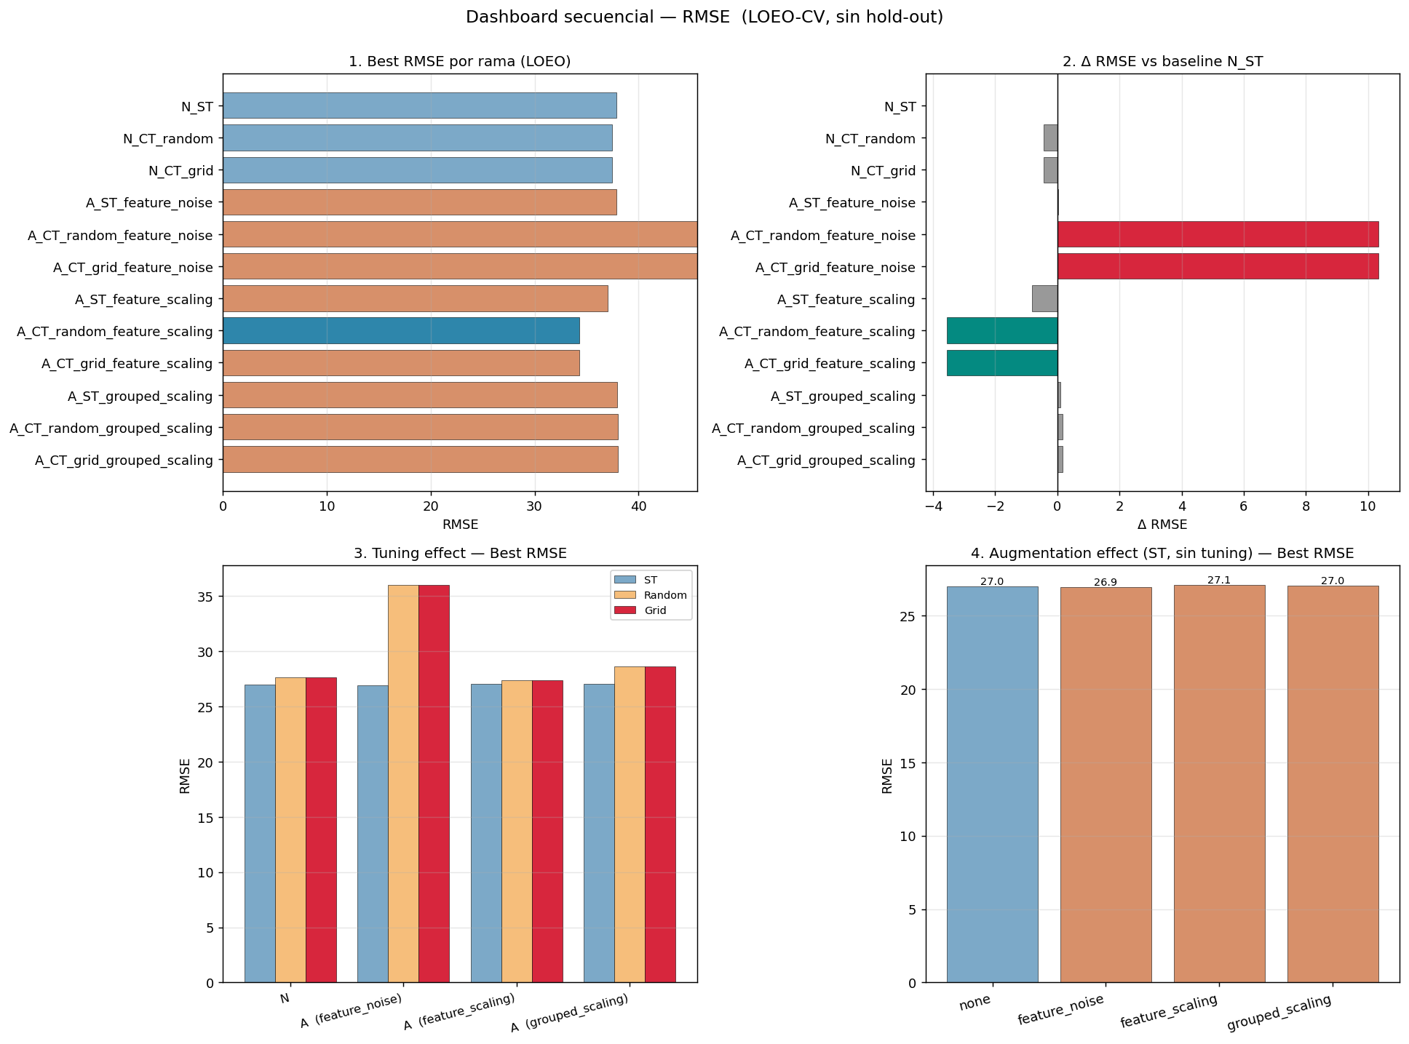
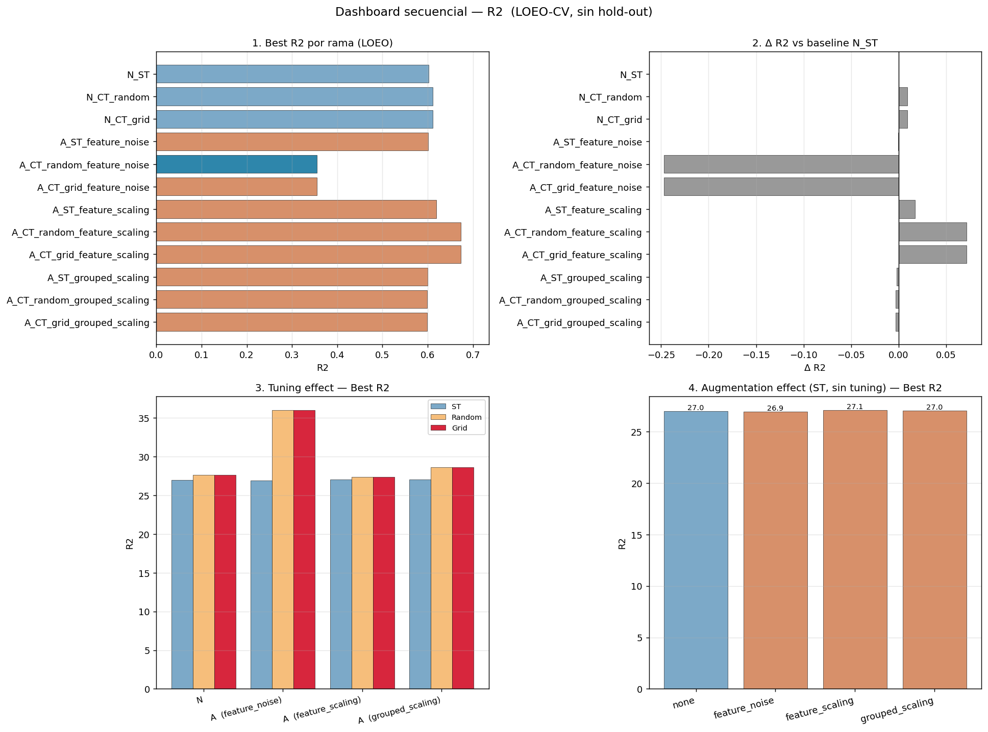
Sequential dashboard — RMSE & R²
On RMSE the picture changes: tuning + augmentation does cut tail error, and R² improves visibly when both are combined.
RMSE
R²

Slide 23
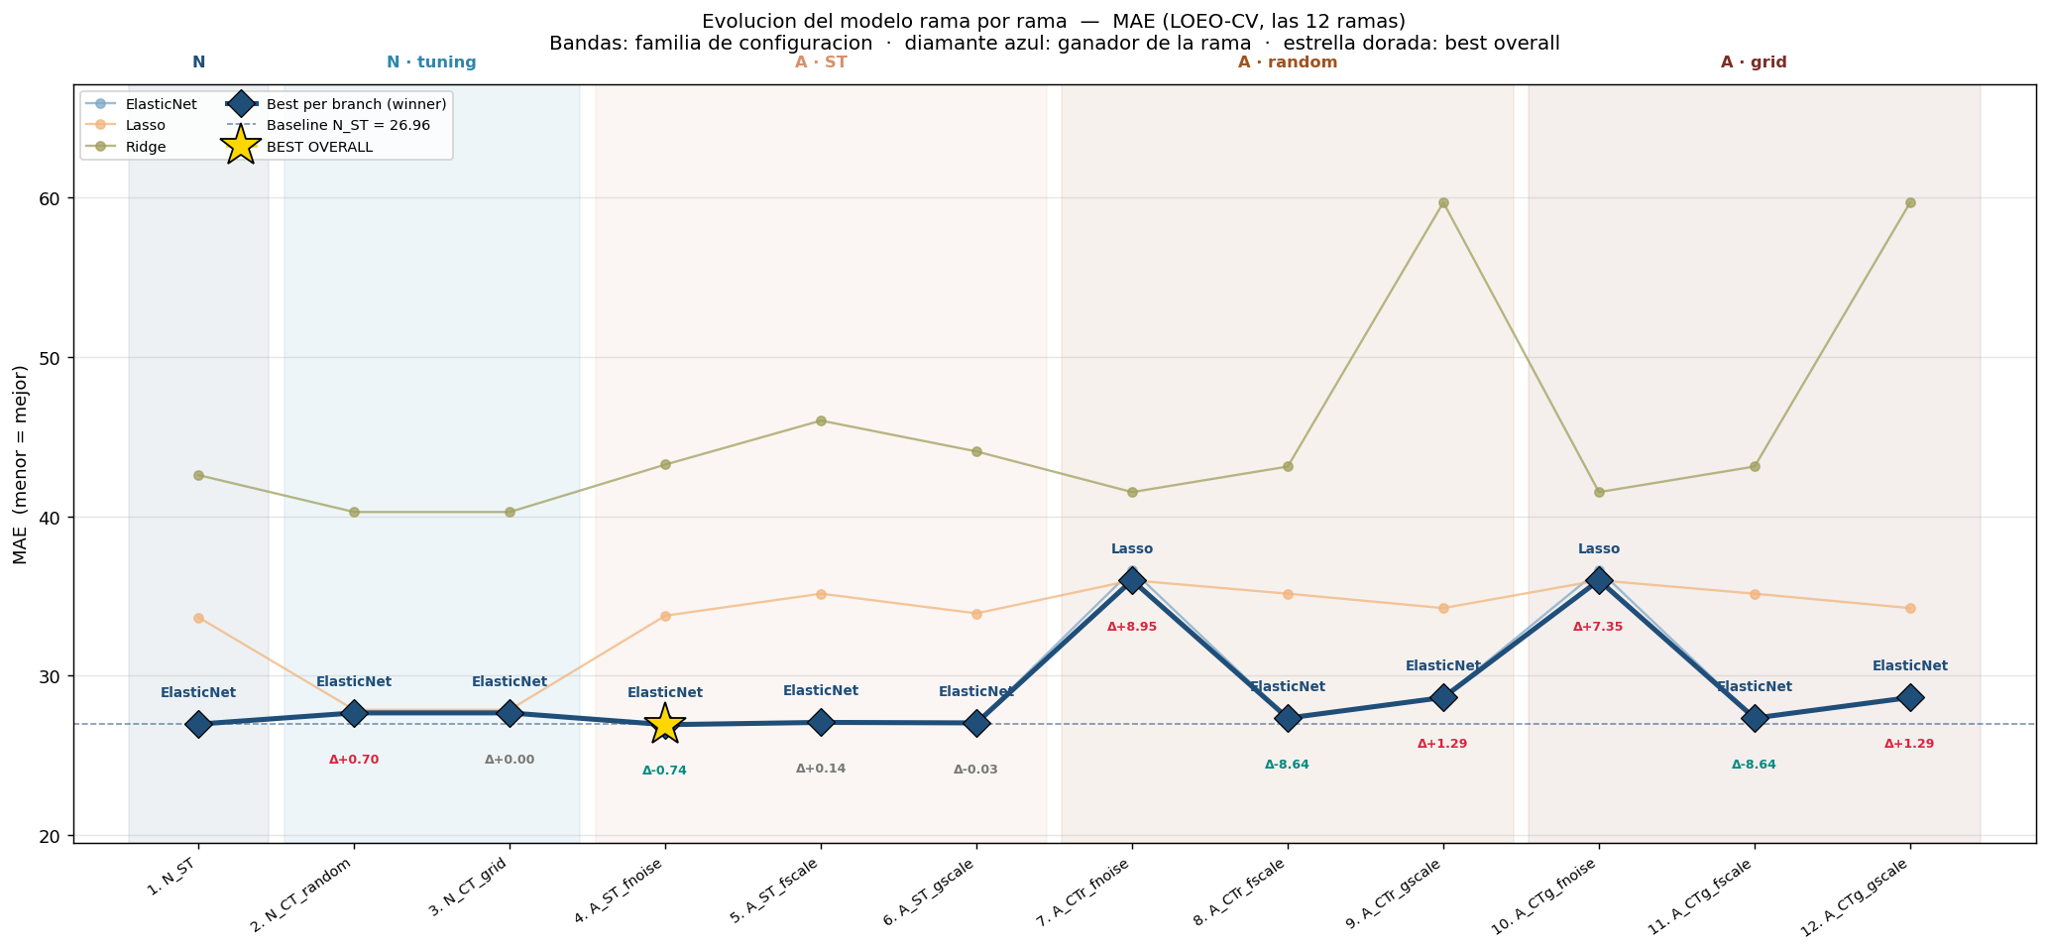
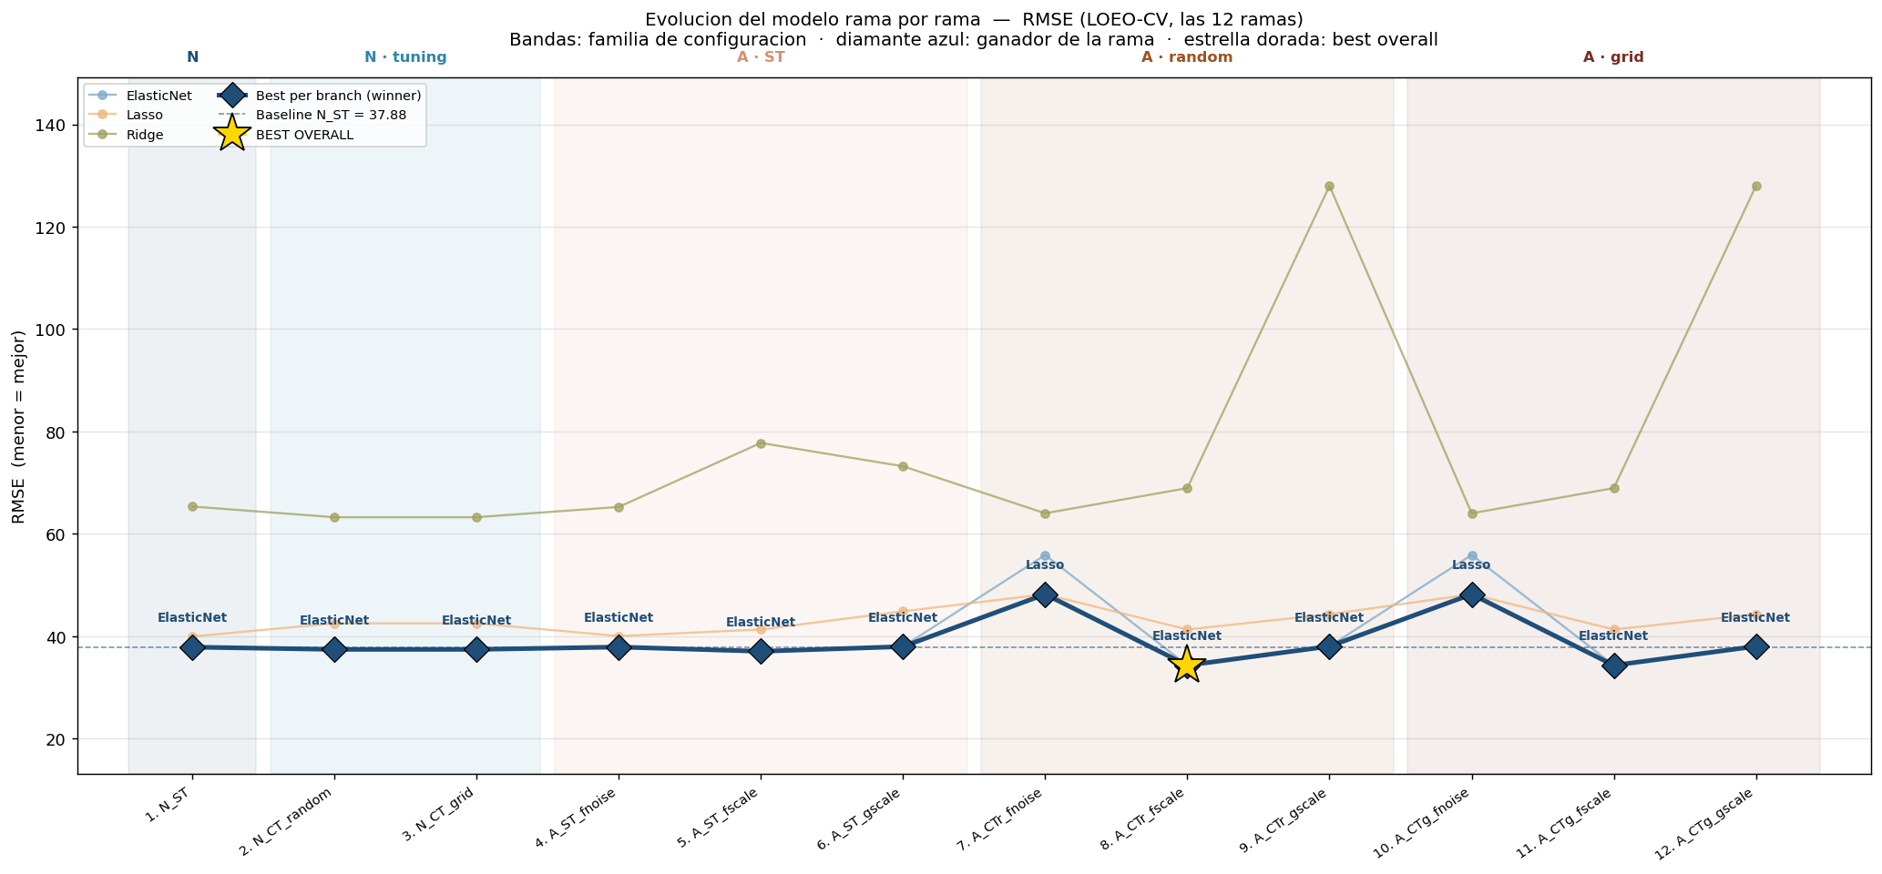
Model evolution — MAE & RMSE
Six progressive stages on the same model. Δ between consecutive stages annotated (green=better, red=worse).
MAE
RMSE

Slide 24
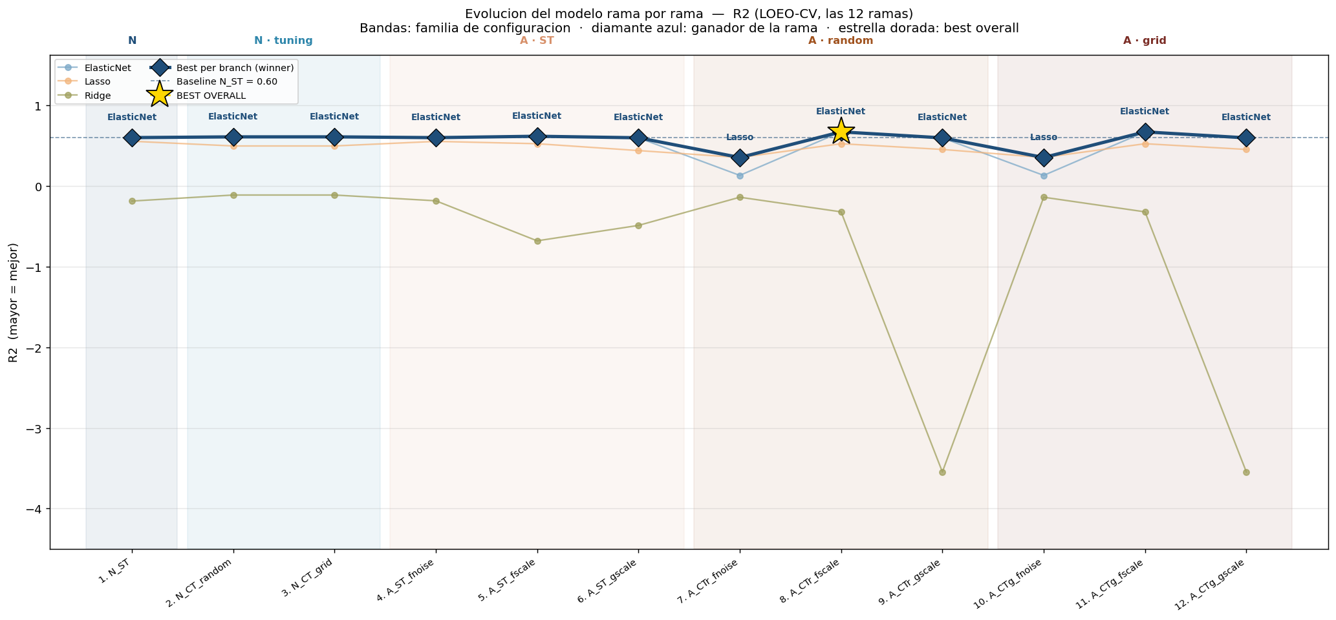
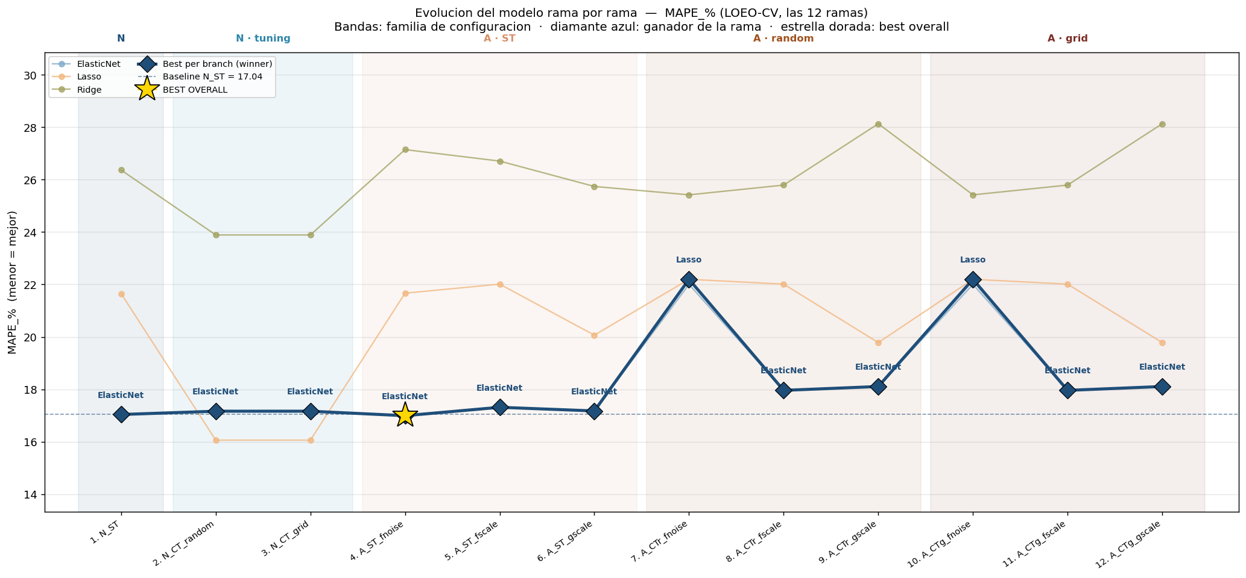
Model evolution — R² & MAPE
R² improves clearly once tuning is added on augmented data. MAPE stays remarkably stable (~17 %), suggesting that the percentage error floor is data-driven, not model-driven.
R²
MAPE (%)

Slide 25
STEP 7
Predictions Analysis
How the predicted VB values line up against the truth, fold by fold. Multi-configuration overlays first, then a deeper look at the best global model.

Slide 26
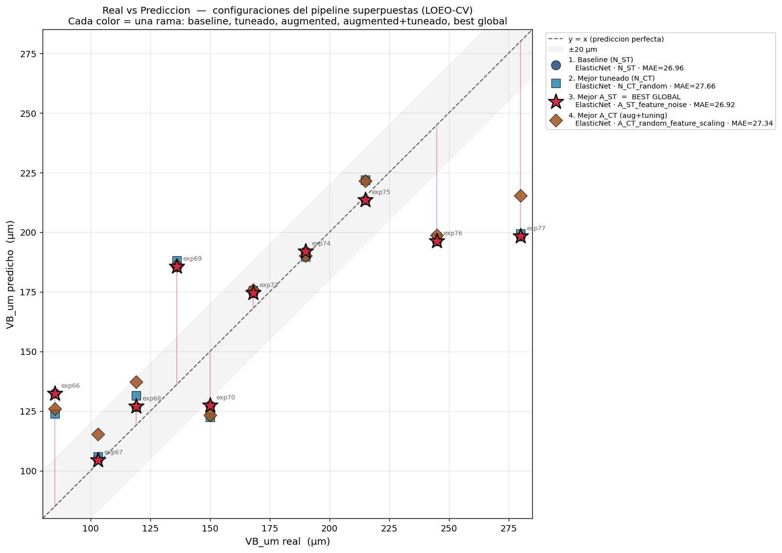
Actual vs predicted — five configurations overlaid
Five colors trace baseline, tuned, augmented, augmented+tuned, and best global. Predictions cluster in the same diagonal — the gain from each stage is small.

Slide 27
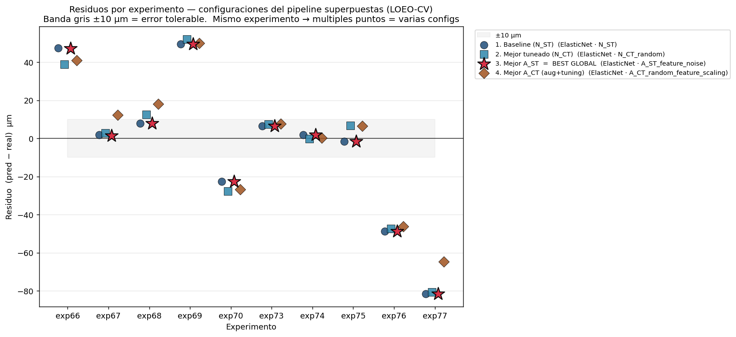
Residuals by experiment — five configurations
Experiment-by-experiment view: the largest residuals occur on a small number of experiments (likely outliers in VB range) — all configurations miss the same ones.

Slide 28
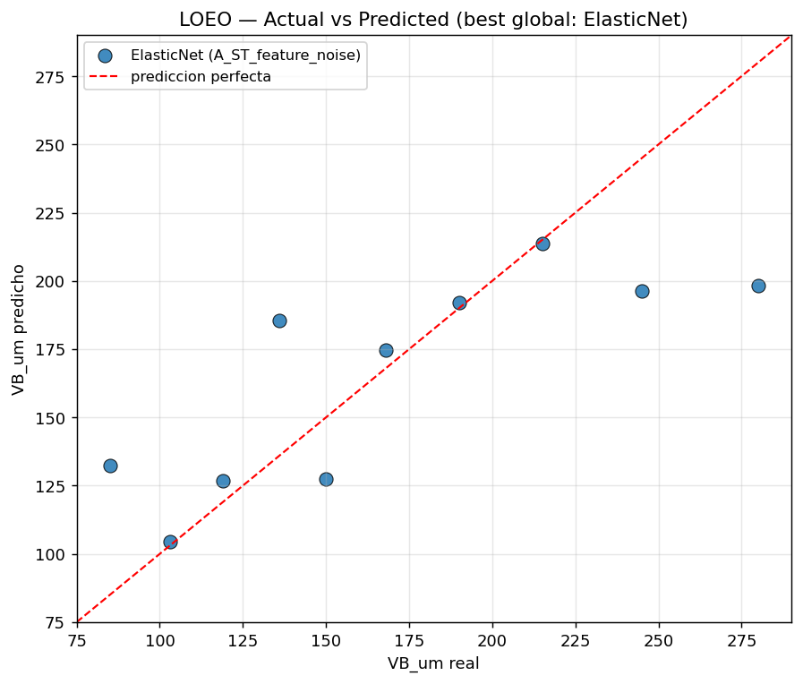
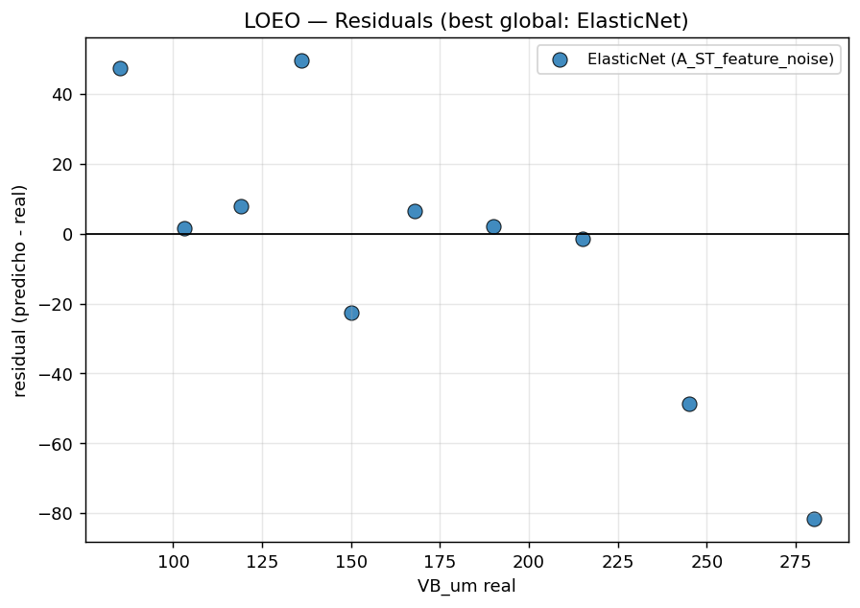
Best global model — ElasticNet on A_ST_feature_noise
Predicted vs actual diagonal and residuals scatter for the winning configuration in LOEO.
Actual vs predicted
Residuals vs predicted

Slide 29
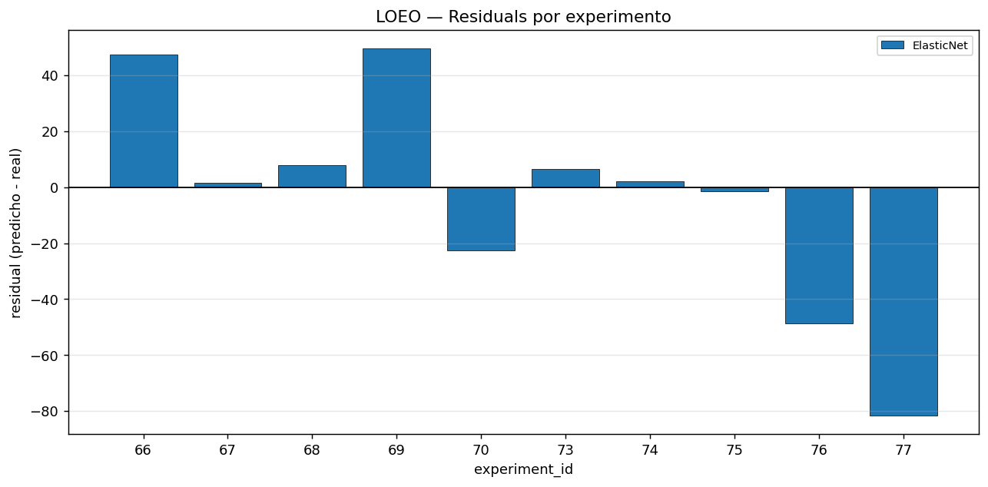
Best global — residuals per experiment
Each bar is one held-out experiment. The error budget is concentrated in 2–3 experiments at the extremes of the VB range.

Slide 30
STEP 8
SHAP — Interpretability (Final Step)
SHAP runs strictly after the metrics have chosen the best models. It does not train, does not tune, does not pick the winner — it only explains why the winning models predict what they predict.

Slide 31
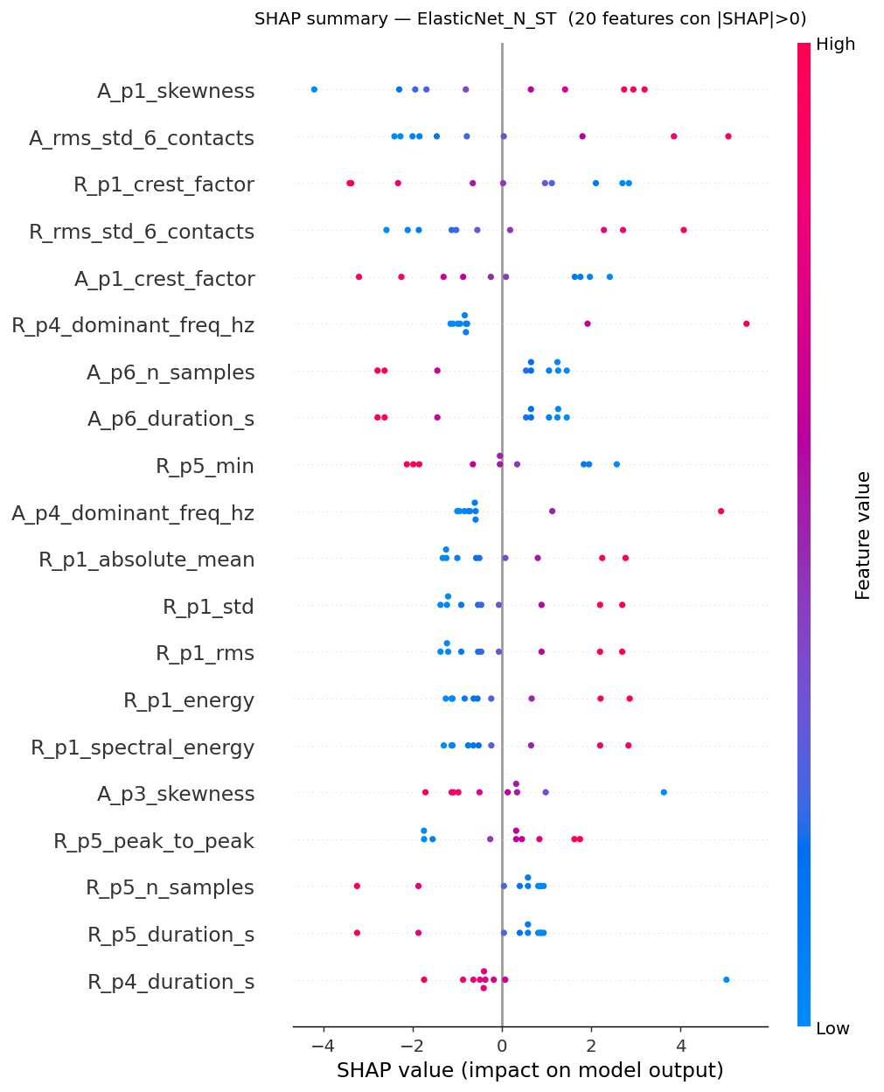
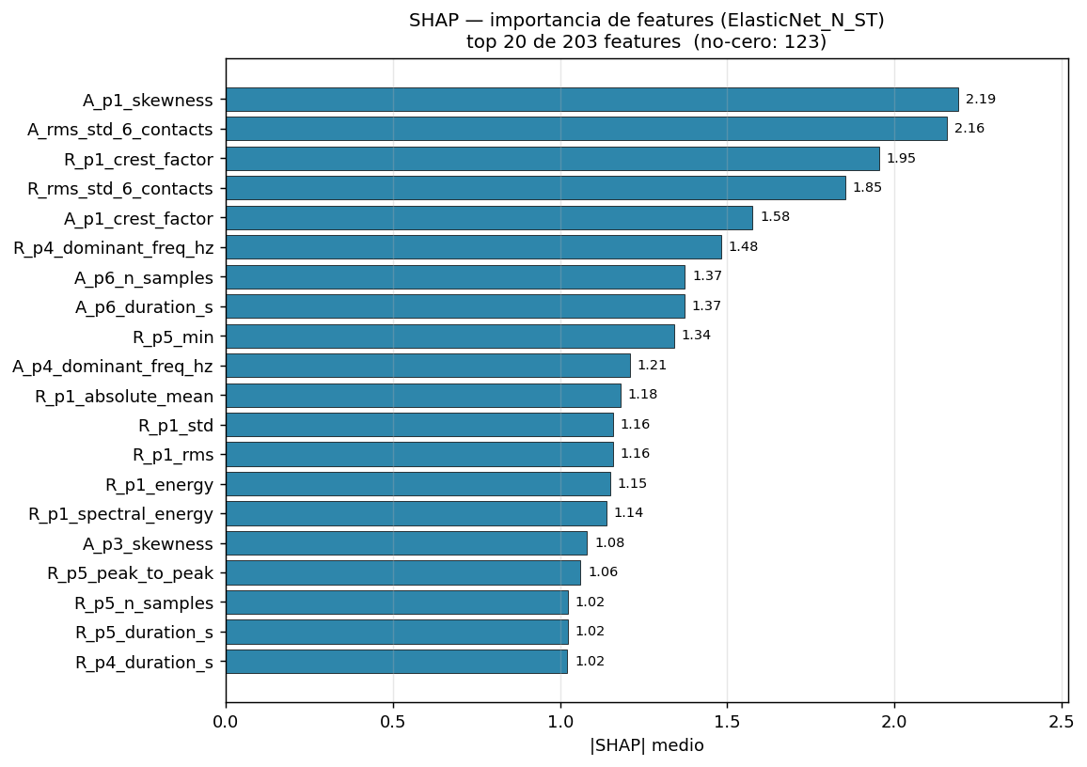
SHAP — ElasticNet on baseline (N_ST)
Mean |SHAP| feature ranking (bar) and signed per-experiment contributions (beeswarm) for the baseline configuration.
Mean |SHAP| importance
Beeswarm — signed contributions per experiment

Slide 32
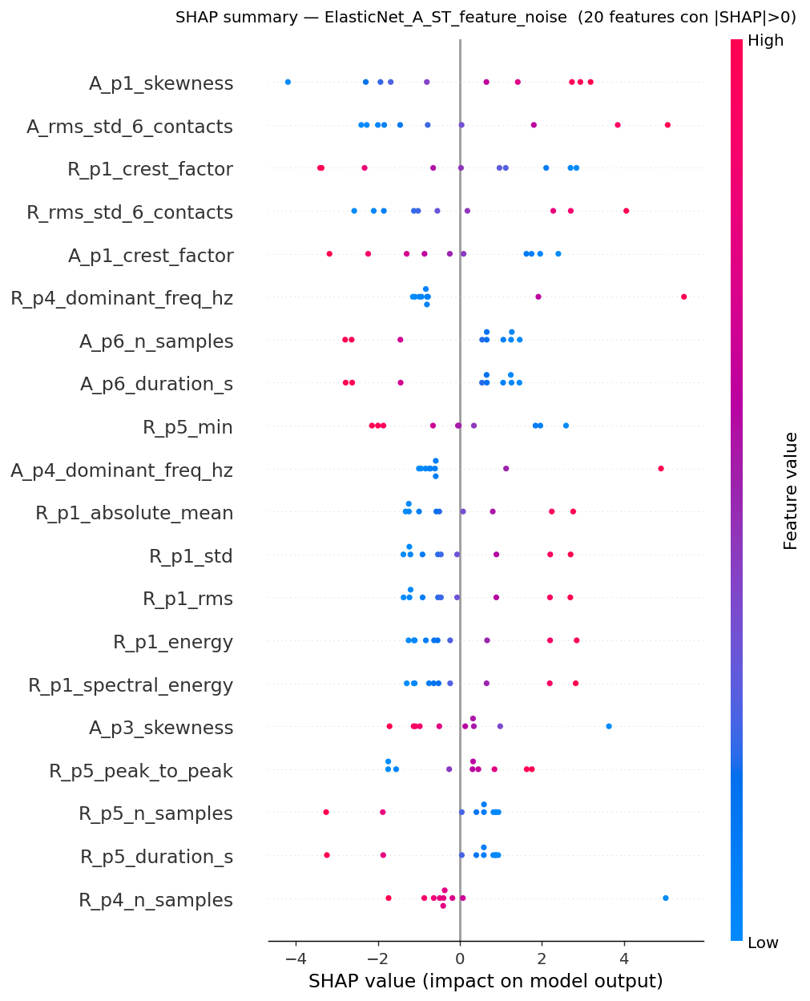
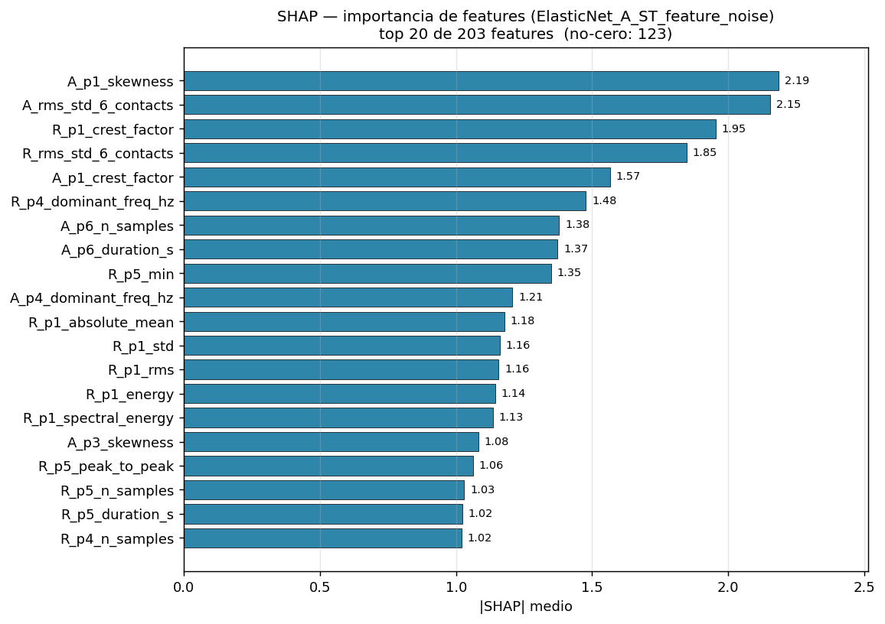
SHAP — ElasticNet on best branch (A_ST_feature_noise)
Same model family, slightly different training noise. The top features are largely the same — confidence that the ranking is not an artefact of one specific augmentation.
Mean |SHAP| importance
Beeswarm — signed contributions per experiment

Slide 33
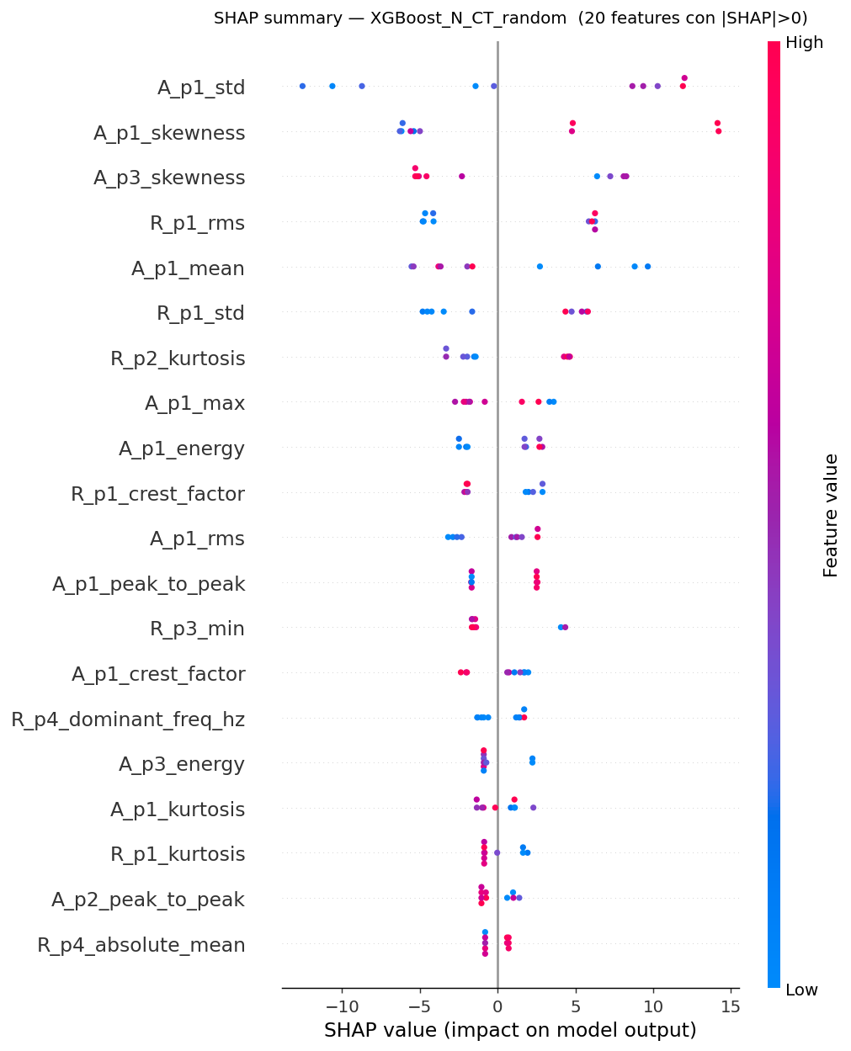
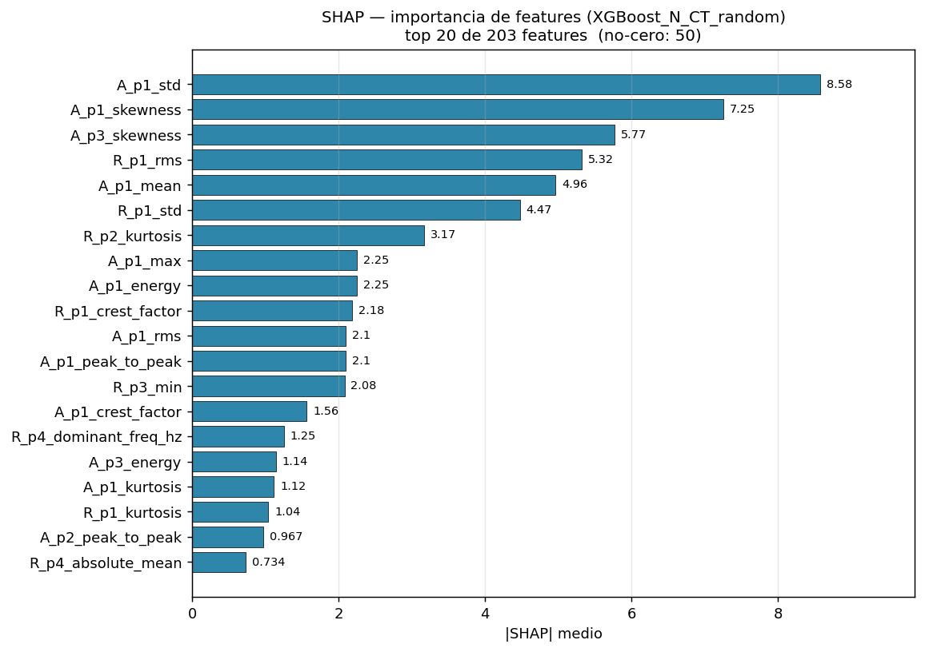
SHAP — XGBoost on N_CT_random (best nonlinear)
A nonlinear sanity check. XGBoost surfaces partially different features and interactions, but the dominant signal overlaps with the linear models.
Mean |SHAP| importance
Beeswarm — signed contributions per experiment

Slide 34
TAKEAWAYS
What this study actually shows
1. Linear-regularized models win
ElasticNet dominates ten of twelve branches. Tree ensembles and kernels are starved by n=8 training rows.
2. Tuning barely moves the needle
Random and Grid converge on the same hyper-parameters. Both deliver sub-1 µm MAE gains over the un-tuned baseline.
3. Augmentation is roughly neutral
feature_noise nudges MAE by ≈0.04 µm; feature_scaling improves RMSE by ≈0.8 µm. No strategy reshapes the ranking.
4. Twelve branches → one ElasticNet
The branching study is most useful as evidence that the choice is robust: roughly the same model wins everywhere.
5. SHAP is the conclusion, not the engine
It runs last, on real rows only, to describe — not decide — which features drive the predictions.
6. Honest about scale
n = 10, one tool. Any |Δ| < 5 µm should be read as noise.

